Slide 1
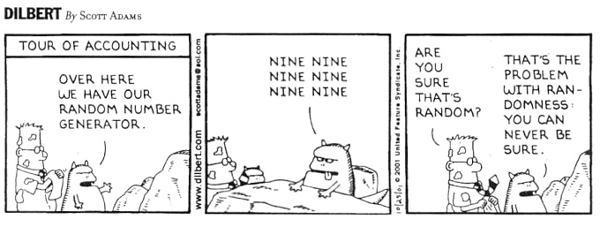

Slide 2
Module 02: Sampling Methods & Designs of Experiment

Slide 3
Population
The Population (or Target Population) is defined as the “group of subjects” we are interested to know something about.
Note the use of definite article “the” above. What does it mean?
“Group of” from the definition means that we have to specify two things in the description: 1) a number (or a count) of and 2) the who.
Problem: We do not know the population size (denoted as N) or how many subjects there are in the population.
So, we simply use the word “all” to replace the unknown number in description.
MLO: Provide a description of the population of interest.

Slide 4
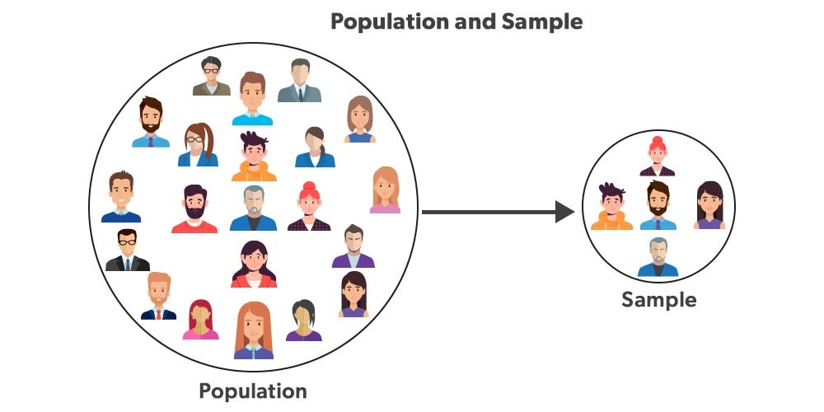
Sample & Sampling Frame
A sample is defined as a sub-group of the population, or a group of subjects that is drawn from the population.
Note the use of indefinite article “a” above. Why?
The definition also has the word “group” in it, but we typically know the sample size (denoted as n) of our sample (or how many rows in the data set).
The sampling frame is essentially the list from which the sample is drawn.
MLO: Provide a description of the sample (drawn) and sampling frame.

Slide 5
Non-Probability Sampling Methods
The first branch of sampling methods is about Non-Probability Sampling Methods.
1) Convenience Sampling Method: choosing subjects by convenience; asking front row students to rate my teaching etc.
2) Judgment (or Purposive) Sampling Method: choosing subjects based on certain pre-determined factors (like gender, race etc.); asking only female students for opinions etc.
3) Snowball (or Chain/Networking) Sampling Method: choosing subjects through indirect contacts; like asking my LinkedIn contacts to share a job opening etc.
4) Voluntary Response (or Self-Selected) Sampling Method: subjects choosing themselves to the sample; like posting your opinion on Twitter/X or on ratemyprofessors.ca etc.
Notable mention: Quota Sampling Method – used mainly as a replacement of Stratified Random Sampling Method (up next).
Notes:
Reference:
https://www.scribbr.com/methodology/sampling-methods/#:~:text=In%20non%2Dprobability%20sampling%2C%20the,snowball%20sampling%2C%20and%20quota%20sampling.

Slide 6
Probability Sampling Methods
The second branch of sampling methods is the Probability Sampling Methods.
1) Simple Random Sampling Method (or SRS): choosing random subjects, like a lucky draw; the fundamental assumption of all statistical tools and formula!
2) Systematic Sampling Method: choosing “skipping” subjects with a random starting point
3) Stratified Random Sampling Method: choosing random subjects from all strata (or homogenous groups)
4) Cluster Sampling Method: choosing all subjects in selected clusters (or heterogeneous groups)
Notable mention: Multi-Stage Sampling Method – 2 or more sampling methods (probability or not) are used at various levels/times.
MLO: Identify and devise sampling methods, given the situation.
Notes:
Note:
Stratified Random Sampling Method is crucial in Machine Learning (later in the program) when selecting the Training datasets and Validation datasets.

Slide 7
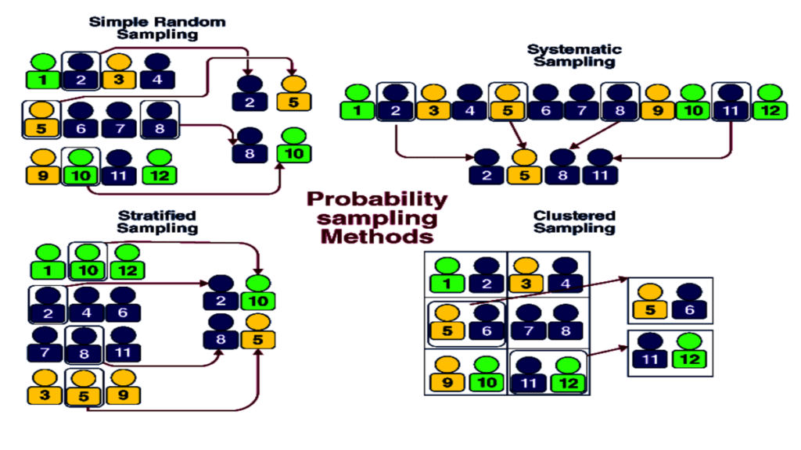
Probability Sampling Methods - Summary

Slide 8
Flaws from Sampling Processes
There are typically two main flaws or issues from the process of sampling.
1) Sampling Error refers to the error that we get when we are collection information from the sample (instead of the population).
The word “error” is loosely defined as the difference between the parameter and a statistic. More in Module 04 about these 2 quantities.
2) Selection Bias refers to the issues that we get when the sample does not represent the target population.
Cautions: Please do not swap “error” and “bias” as they refer to different things.
Error (in general) goes down when sample size (n) goes up.
Bias (in general) does not change when only the sample size is increased.
MLO: Identify and justify if a sampling process contain any flaws.

Slide 9

Selection Bias and Non-Response Bias
Notes:
URL: https://www.youtube.com/watch?v=EZrP_av3cmA
Duration: 1m52s
Please watch this at your own time.

Slide 10
Designs of Experiment (or DOE)
Everything we have learned about sampling processes is under a big umbrella term of Observational Studies, where subjects are observed (or data are recorded).
More importantly, the subjects are not manipulated or instructed to do or intake anything before or during the observation (or data collection) part.
In contrast, Experimental Studies (or Designs of Experiment) will assign subjects randomly into one of the many treatment groups, and then the observation (or data collection) takes place.
Although DOE is not used prominently or needed in usual business settings or data science field, it is still imperative you know the key points.

Slide 11
DOE Terminology
Guess what, it has it own set of lingo (or terminology).
Subjects = experimental units (I’d stick to subjects in this course)
Y-variable = response or response variable
X-variable (categorical variable) = treatments
Classes of X-variable = levels or interventions (mainly used in health care)
 | Subjects | Y-Variable | X-Variable | Classes of X-variable
Observational Studies | Subjects | Response Variable | Predictors | --
Experimental Studies | Experimental Units | Response | Treatment(s) | Levels or Interventions

Slide 12
Other Important Terminologies
1) Treatment Group(s) vs. Control Group
Subjects in treatment groups are getting, well, treatments, like real medicine, while subjects in the control group are not getting any medicine or getting placebos.
A placebo is simply something looks, feels and possibly tastes exactly the same as the medicine treatment group subjects are getting.
2) Single-Blind (or Masking) vs. Double-Blind
Single-blind: subjects do not know which treatment group they belong to but the person conducting the experiment knows
Double-blind: neither the subjects nor the person conducting the experiment knows; but the statistician (probably working off-site) knows
MLO: Identify and apply various terminologies in DOE.

Slide 13
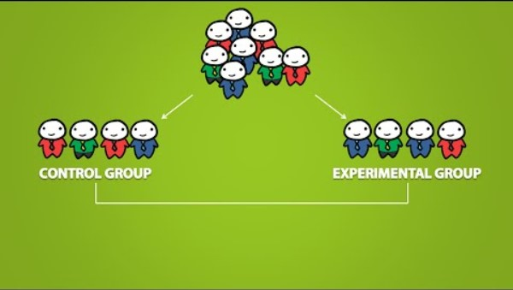
Experiment Lingo
Notes:
URL: https://www.youtube.com/watch?v=GMqrOdCx4Yg
Duration: 3m35s
Please watch this at your own time.

Slide 14
(Common) Experimental Studies
1) Comparative Randomized Design: restricted to 2 levels of one treatment
E.g.1 A teacher wants to compare students’ performance (measured in % of final exam) from two teaching methods (traditional way vs. flip-classroom)
2) Completely Randomized Design (or CRD): it basically covers all other studies (2 or more treatments, each with 2 or more levels)
E.g.2 A teacher wants to compare students’ performance (in final exam %) from two different treatments: Treatment A = teaching method (2 levels); Treatment B = assessment method (2 levels = essay writing vs. MCQ)
3) Randomized Block Design: it is basically CRD plus a “block” (a categorical variable that you think would have an impact on the response)
E.g.3 Using e.g.2 plus adding a blocking factor with 2 levels (students working part-time vs. students not working)
MLO: Identify and devise the experimental studies in schematic diagram, given the situation

Slide 15
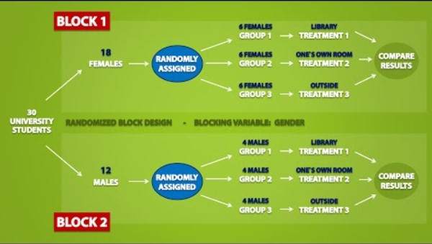
Types of Experiments
Notes:
URL: https://www.youtube.com/watch?v=10ikXret7Lk&t=289s
Duration: 6m36s
Please watch this at your own time.

Slide 16

Any Questions?

